Slide 1
PEGA
Debugging Tools

Slide 2
Additional requirements

Slide 3
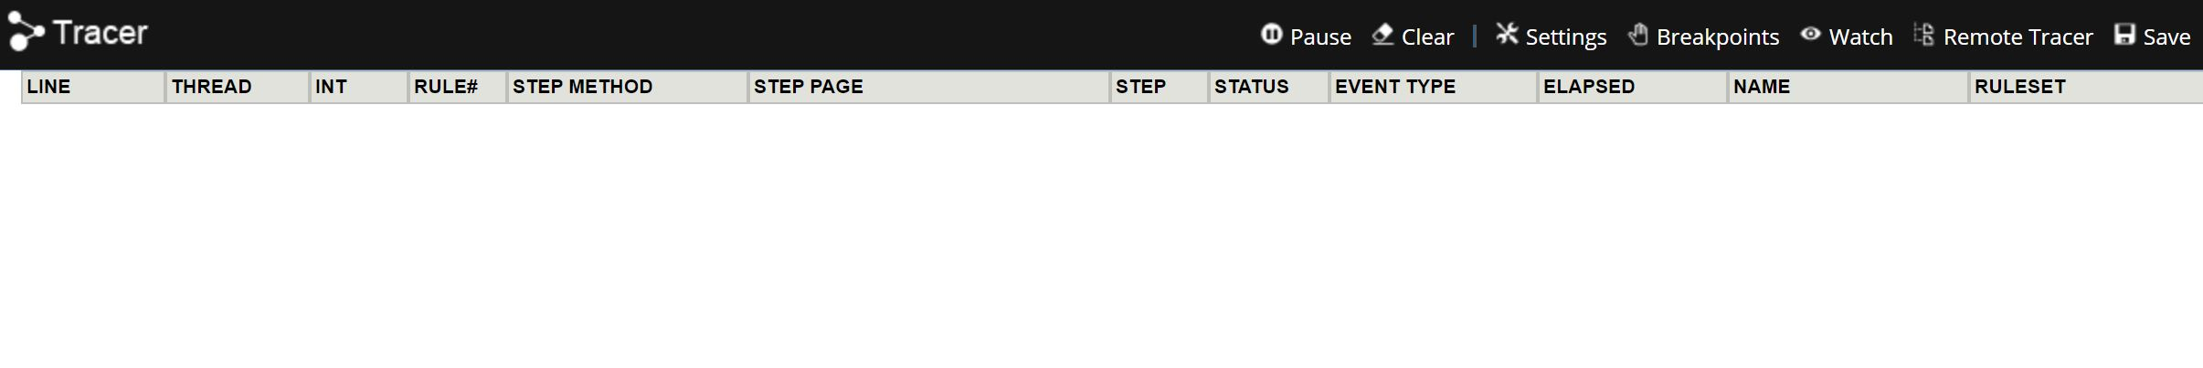
Tracer
Tracer tool is used to test and debug activities, flows, and other rules.
We can see the processing performed during run-time in summary or in detail.
You can pause and resume processing, view or set the value of watch variables, and drill down to step-by-step details.

Slide 4
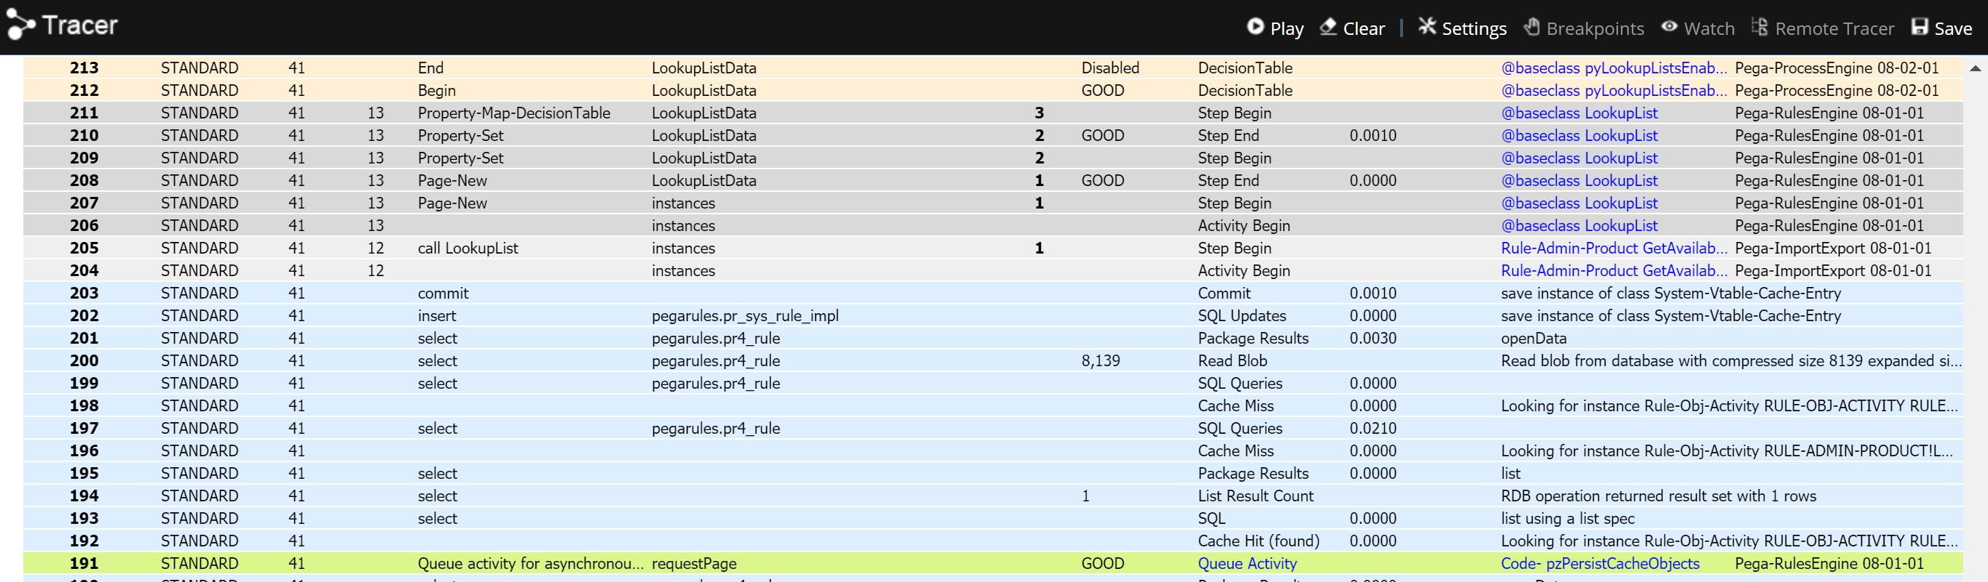
You can view trace events for any requestor connected to your server node, not just your own session (if you know the connection ID of the session).
When you first open the tool, the rows of the Tracer results display are empty.
When you take a subsequent action in the system, the Tracer tool adds rows according to the trace criteria specified in the Trace Options.

Slide 5
By using various Trace options, you can set very fine-grained control over what you wish recorded in the execution trace.
You can specify the applicable events, break conditions, and targeted RuleSets.
Drilling down on event details
You can interact with the Tracer tool's results display to drill down for more information on specific events.
By clicking on the values in the display columns, you can learn more about the event associated with that row, including seeing a Java stack trace if an exception occurred.
In the Tracer results display opens a window that shows many facts about that event, and clicking the name of the primary page opens a window that shows information about that page.

Slide 6
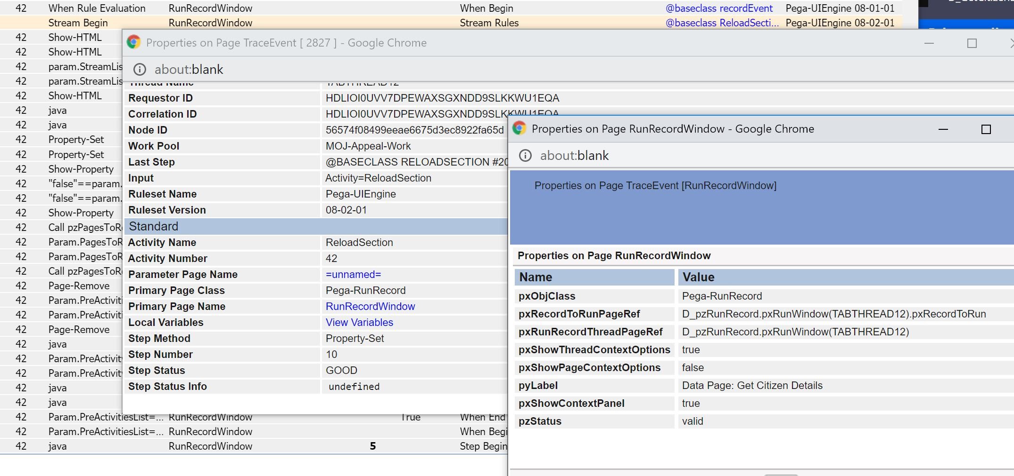
8.4 new features

Slide 7
ClipBoard
Use the Clipboard tool when developing and debugging to:
Examine property values and messages associated with them
Find the information necessary to reference a property — the page names and the property name
Quickly create, update, delete, and modify pages using the Action menu
Quickly start activities and flows using the Action menu

Slide 8
The clipboard has a hierarchical structure based on XML. It resides in memory on the server.
The Clipboard tool displays two panels:
The left panel displays the page structures, in a hierarchical tree format.
The right panel displays the value of Single Value, Value List, and Value Group properties and messages, for one page selected in the left panel.
To interact with your clipboard:
Select a Thread from the right panel Thread menu. For Threads that correspond to a work item, the menu identifies the work type and work item ID as well as the Thread name.
Interact with the tree structure in the left panel to select a page, list, or group.
Review or interact with the right panel.

Slide 9
You can control whether the Clipboard tool opens in a new window or in the lower half of the Designer Studio workspace.
Select Preferences from the Application menu.
Select or clear the Clipboard box in the Tools group.
Click Save.

Slide 10
The clipboard contains three groups of pages:
User Pages — Top-level pages created by your normal processing, sorted alphabetically by page name.
Declared Pages — Read-only declarative pages (created if necessary when accessed, defined by declare pages rules.
Linked Property Pages — Read-only pages retrieved because a harness, section, flow action or other rule contained a property reference based on a linked property. These pages are read-only, and never updated. They are removed automatically whenever your requestor performs any Commit operation.
Three top-level pages are always present:
pxThread — A single system-maintained page known as the Thread page.
pxRequestor — A single system-maintained page known as the requestor page, which contains information about your access roles, RuleSet list, and HTTP protocol parameters.
pxProcess — A single system-maintained page known as the process page, which contains information about the server's Java Virtual Machine and operating system.

Slide 11
UI Inspector
UI inspector tool is used to view the hierarchy of artifacts in your application UI.
Inspect the harnesses, sections, containers, layouts, cells, and properties of your application at runtime.
Make UI adjustments at runtime and publish or discard changes on the fly.
Logs
From the System Operations landing page, you can view and download log files and access the purge and archive utilities.
The Pega Log — also known as the console log or system log — contains messages created since the server was most recently started.
The log file is usually named PegaRULES-YYYY-MMM-DD.log, where the date portion of the name indicates the date the application server was recently started (on the current node).

Slide 12
Logs
Types of logs
Which logs appear depend on the contents of the prlogging.xml file for this node. You may see the following:
PEGA — A text file containing warnings, errors, and information messages about internal operations
ALERT — Performance-related alerts triggered by prconfig settings (or implicit, default values.) A text file with fields separated by single asterisk character. User the PLA tool to parse and summarize this file into a Microsoft Excel spreadsheet.
ALERTSECURITY — Alerts (identified by the prefix SECU) that suggest improper configuration of Internet Application Composer facilities, or overt attempts to bypass system security features through URL tampering.
BIX — Log files created during extract operation rules by the optional Business Intelligence Exchange product.
SERVICES-PAL — A Comma-Separated-Values file with performance data saved from services.

Slide 13
Viewing the logs
Click a file name to view one of the logs.
Typically the date portion of the file name indicates that this file contains only log.
The initial display shows only lines of the log for your own Operator ID (for all your sessions on this node), in pages of 25 lines each.
Click a number at the bottom of the display to see the corresponding page, or next to see the next group.
Downloading a log
Click either of the text links to download a log as a text file (with txt as the file type).
Click the zip links to download a log as a ZIP file.
Application server authentication may be required.
Access is controlled by the PegaDiagnosticUser role in the web.xml file for the DiagnosticData servlet.

Slide 14
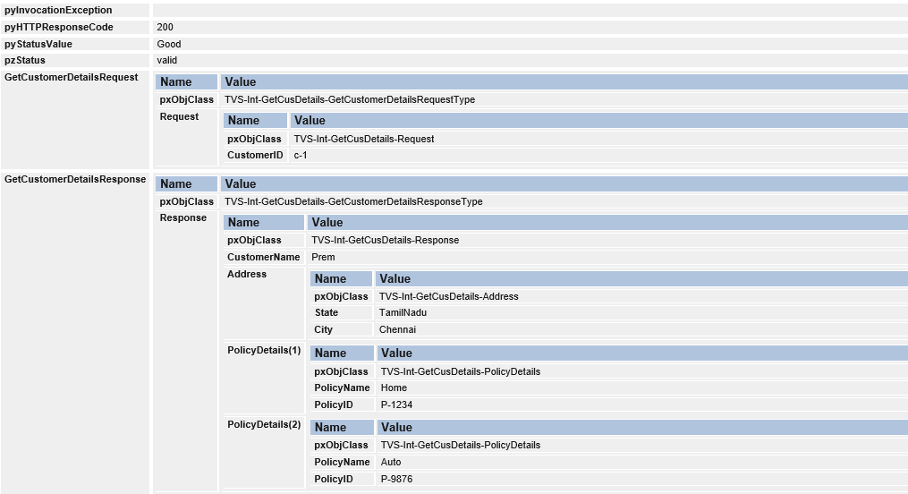
Tracing Request and Response
Trace open the rule and run the activity.
Click on the step page to check the response.
Below is one example where service returns the result.

Slide 15
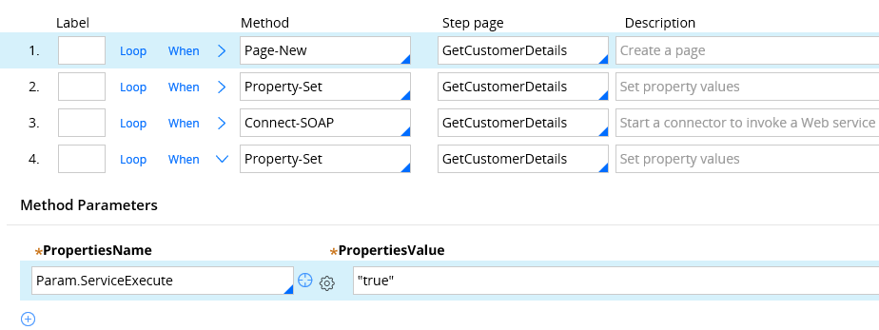
How to Error handle in Connect-SOAP rule
There are 3 ways to error handle
a) Transition step in connector activity.
b) Using Error handler flow in connect-SOAP rule service tab
c) Using faults tab in the Connect-SOAP rule
Pre-requisites to test transition error handling
1) Add a step to set parameter ServiceExecute to ‘true’ – Success Condition.

Slide 16
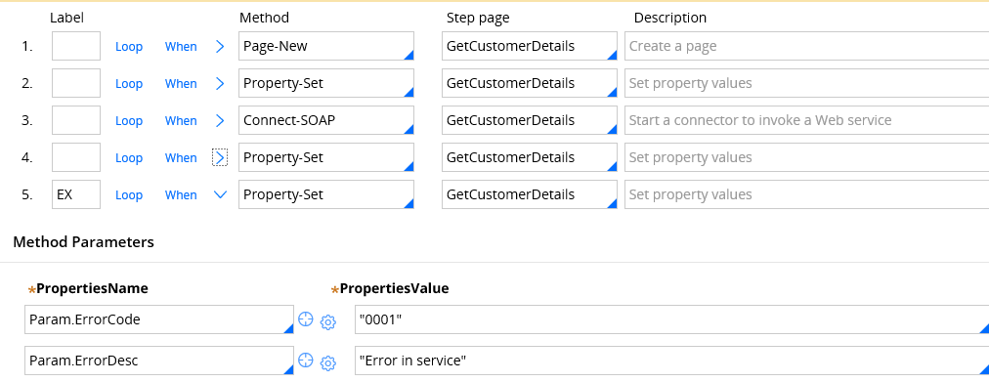
2) Now add step 5 to set error code and error desc parameters.

Slide 17
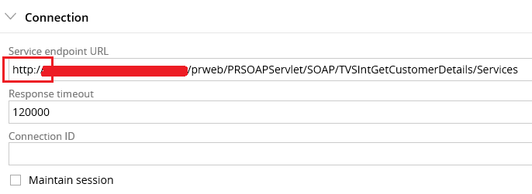
3) In the Connect-SOAP rule, update the endpoint URL from https -> http ( you can reverse in your own choice)
First, I didn’t add any transitions in the Connect-SOAP method.

Slide 18
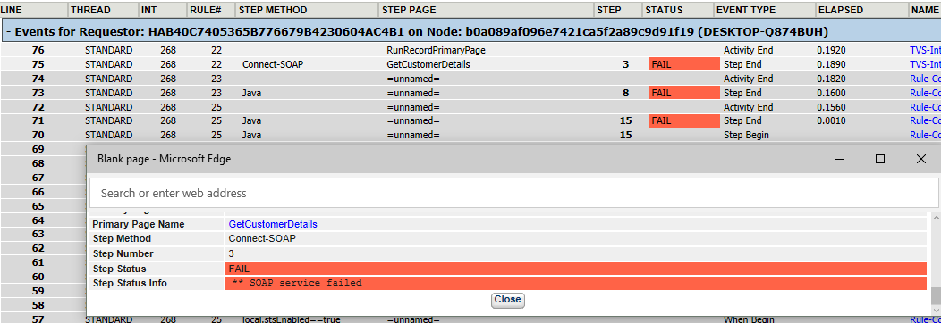
Now trace open the rule and run the activity.
You can see activity run, throws exception and abruptly stops at step 3.
This will cause the run time exception and stops the process.
You may get the same error screen in user portal.

Slide 19
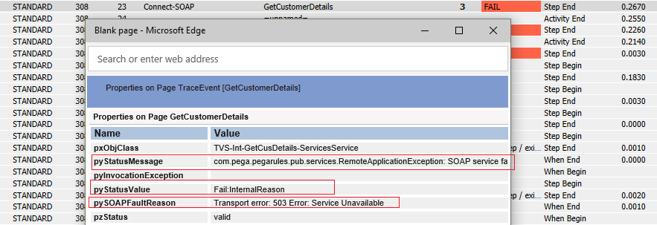
Additional requirements
You can also click on the step 3 step page to check the error handling property values.

Slide 20
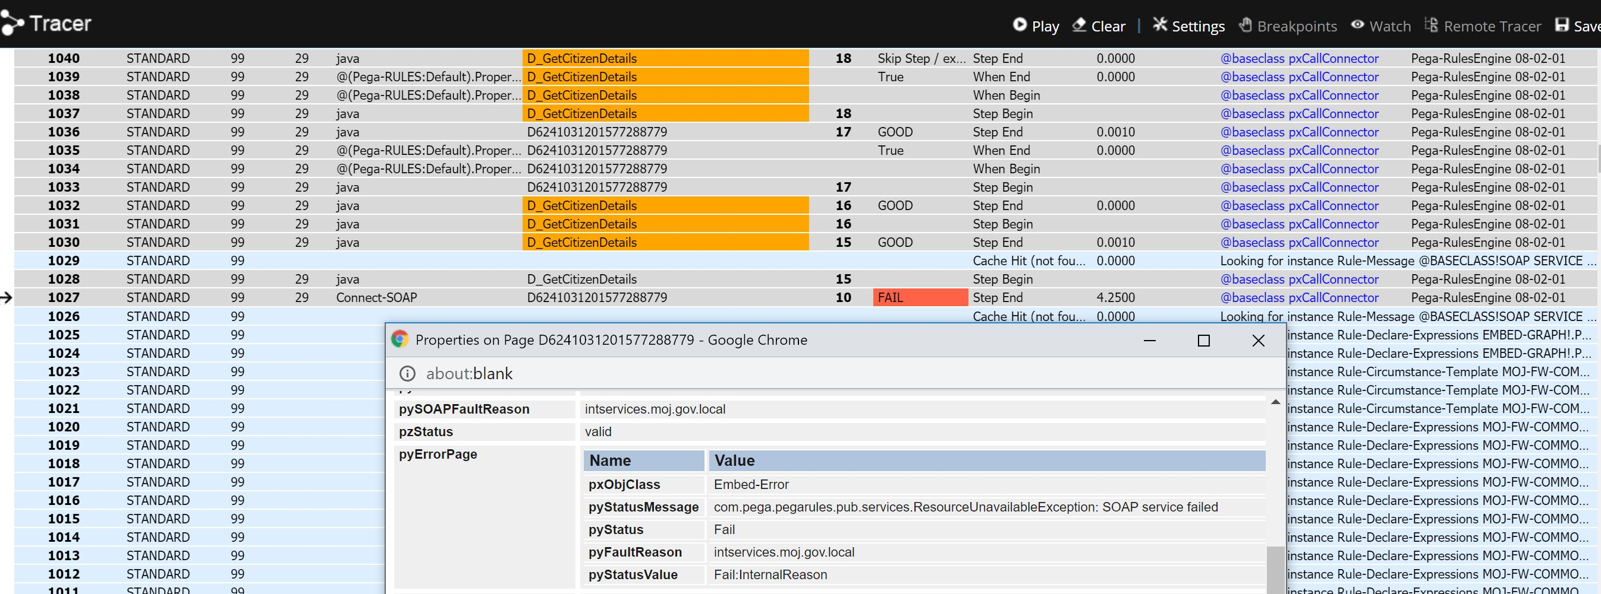
Below is the screenshot of the one of the appeal application connect-soap rule which is traced.

